Slide 1

TVS Interview project
Ramakrishnan thiyagu

Slide 2
Problem Statement
As a Logistics company it is necessary to provide effective trip experience to the customer in an optimized cost.
To provide an effective service we need to identify the parameters that impact the on time arrival of the truck.
With the pattern formed we need to formulate the data points that would help reduce the trip cost

Slide 3
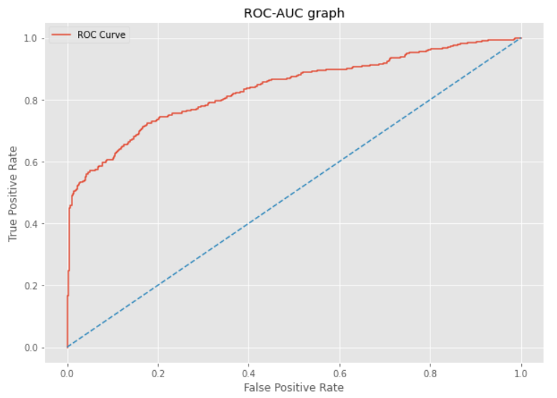
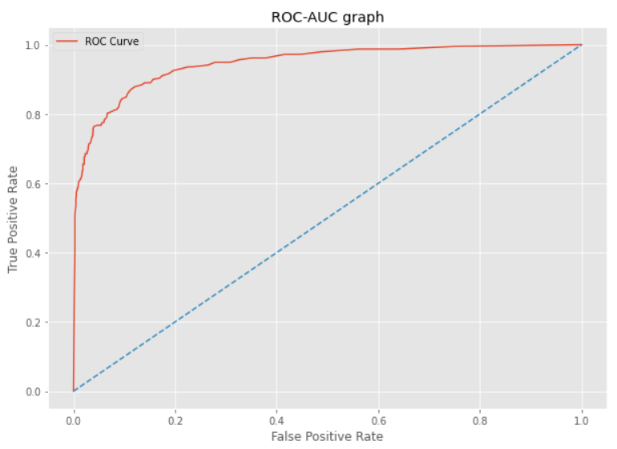
Logistic Regression vs Random Forest

Slide 4
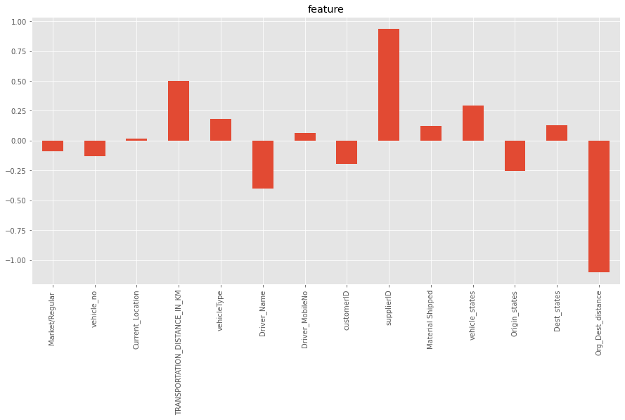
Parameters that impact the on time arrival of the truck
Current location
Transportation distance
Vehicle type
Driver mobile number
Supplier
material shipped
Vehicle state
Destination state

Slide 5
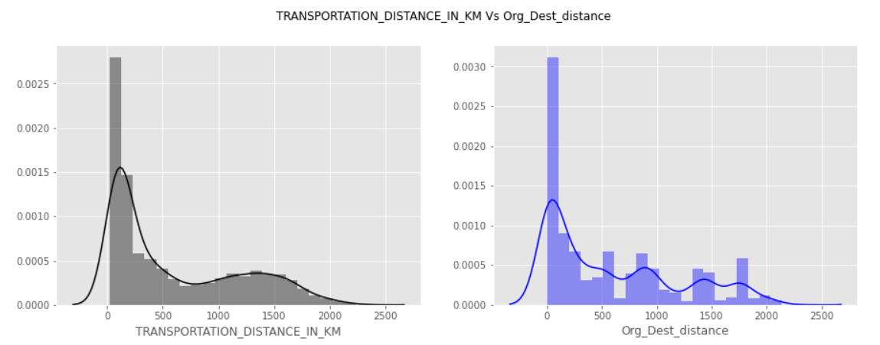
Parameters that would reduce trip cost

Slide 6
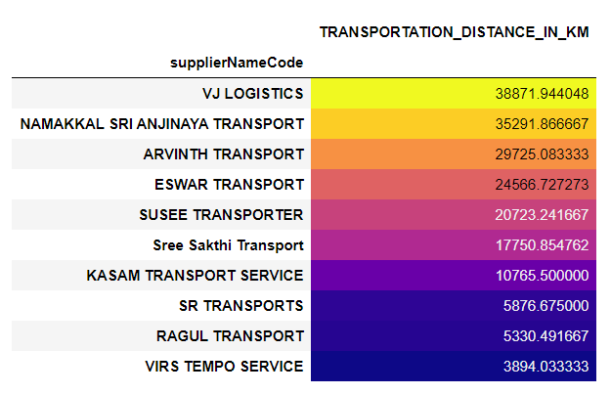
Parameters that would reduce trip cost
Destination and origin location are same.
There are some kms mentioned in Transportation distance.
Possibly suppliers entered fraudulent data. If not we need to concentrate on it more.
Possibly Fraudulent entries by suppliers

Slide 7
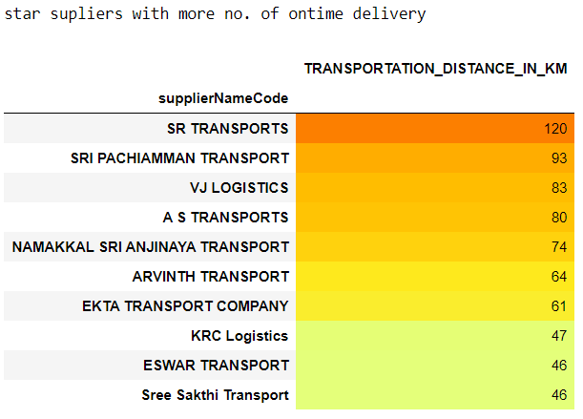
Parameters that would reduce trip cost
Suppliers who are making more number of on time deliveries
Supplier name and their respective on time deliveries
If our trip cost and profit is based on count of deliveries we can analyse the counts or if it is based on kms we can analyse the same by kms

Slide 8
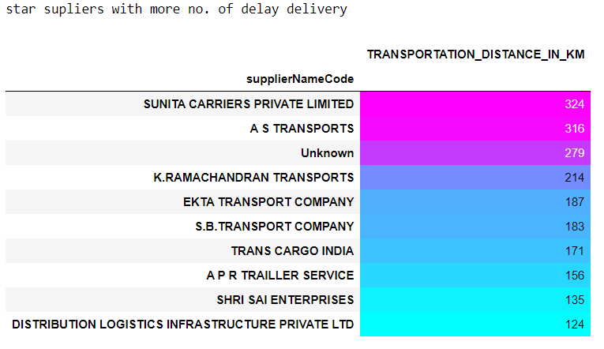
Parameters that would reduce trip cost
Suppliers who are making more number of delay deliveries
Supplier name and their respective on time deliveries
If our trip cost and profit is based on count of deliveries we can analyse the counts or if it is based on kms we can analyse the same by kms
We have some unknown names. We need to make sure that we are recording transportations with suppliers name to get best result

Slide 9
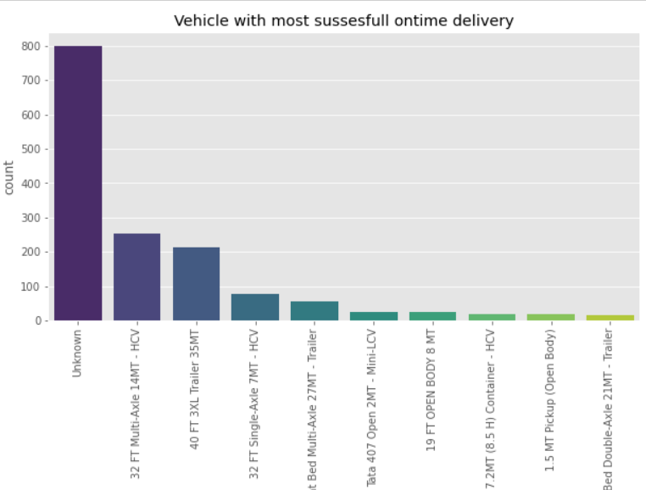
Parameters that would reduce trip cost
Here we are having more unknown names for vehicle type.
And those are making more successful ontime deliveries.
We should make sure the we are always having vehicle name also in out data.
Next to unknow we have '32 FT Multi-Axle 14MT - HCV’. This type vehicles are making ontime deliveries more so we can go for suppliers who are having this vehicle with them more

Slide 10
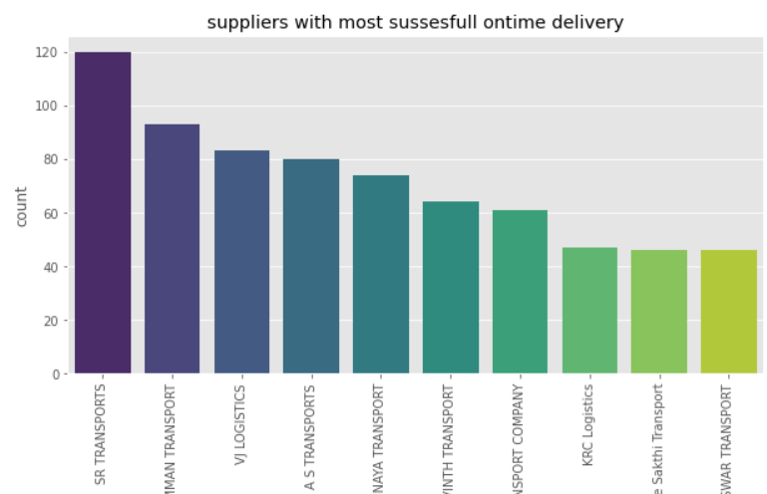
Parameters that would reduce trip cost
By this result SR Transports are making more successful on time deliveries.
so we can make more ontime deliveries by analysing these top suppliers and finding how they differs from other suppliers.
And in future we can go for these suppliers.

Slide 11
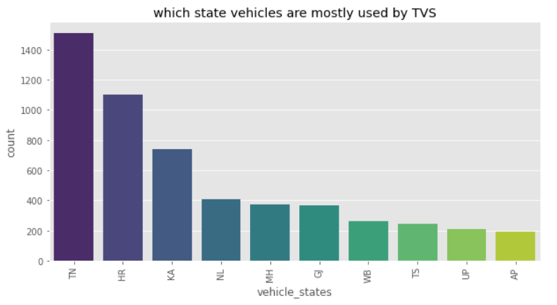
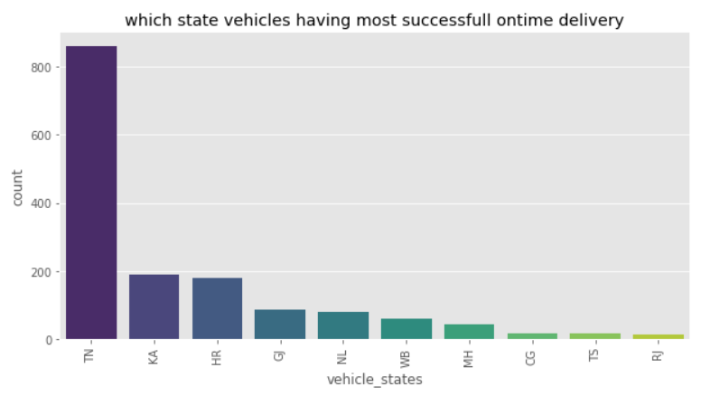
Parameters that would reduce trip cost
We are using vehicles from Haryana, Karnataka and many more
But other state vehicles are not making more ontime deliveries.
May be the drivers are not much aware of routes. Or we can do further analysis over this issue to reduce the trip cost

Slide 12
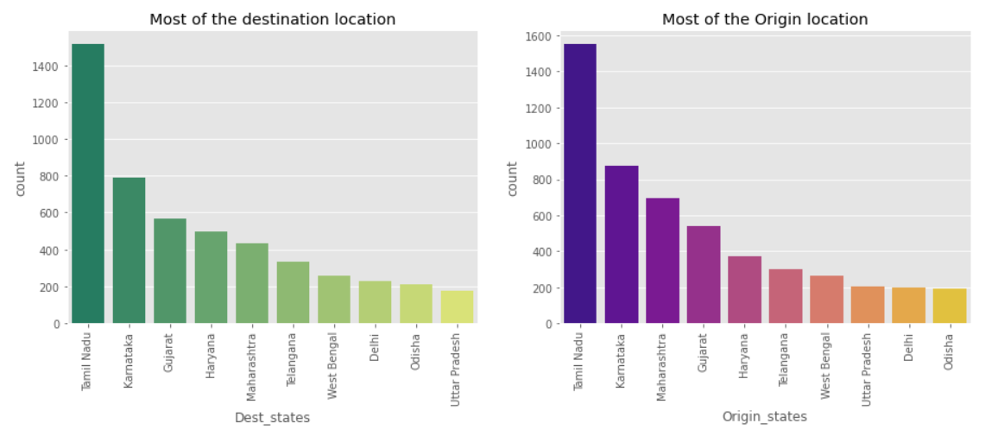
Parameters that would reduce trip cost
Most of out deliveries are inside Tamilnadu only, this is probabily the reason for the delay for other state vehicles and drivers. Better we will go with suggesting shortest path to reduce trip cost and ontime delivery

Slide 13
Future analysis
We can suggest shortest route and between origin and destination to the drivers by finding it from google maps API and google distance matrix API by using personal client API.
By using the same we can find shortest duration and finetune our planned_ETA.

Slide 14
Thank you

